Slide 1
Abstract
Electrocardiogram (ECG) signal classification is fundamental for diagnosing cardiovascular diseases.
However, ECG signals are prone to noise interference, complicating accurate classification.
This paper presents an approach combining denoising techniques and feature learning to improve ECG signal classification accuracy.
Objective: Enhance accuracy of ECG signal classification for cardiovascular disease diagnosis.
Method: Combine denoising techniques with advanced feature learning.
Denoising Techniques: Develop effective methods to remove noise from ECG signals.
Feature Learning: Explore advanced techniques to extract meaningful features from denoised signals.
Improved Accuracy: Aim to improve classification accuracy by distinguishing normal and abnormal heart signals.

Slide 2
Introduction
Heart signals (ECGs) are important for finding heart issues, but they often have noisy distractions. This makes it hard for current methods to spot problems accurately. We need new ways to clean up the noise and find the real issues in the signals.
Heart problems pose a significant global health challenge, requiring precise diagnosis.
Unfortunately, noise frequently distorts ECG signals, making it challenging to identify issues accurately.
This presentation introduces a novel approach to address this issue.
By effectively removing noise and pinpointing essential patterns, it aims to enhance the accuracy of heart issue diagnosis.

Slide 3
Dataset :MIT-BIH Arrhythmia
Background: Established in 1975, MIT-BIH Arrhythmia Database is a collaborative effort between Beth Israel Hospital and MIT. It serves as the first widely available dataset for arrhythmia detector evaluation and cardiac dynamics research.
Data Description: Consists of 48 half-hour ECG recordings from 48 subjects, digitized at 360 samples per second per channel. Includes comprehensive annotations by cardiologists for approximately 110,000 beats.
Release Info: Continuously updated, with half the database freely available since 1999 and the remaining records released in 2005.
Related Databases: Linked to MIT-BIH Noise Stress Test Database for stress testing arrhythmia detectors and MIT-BIH P-wave Annotations for P-wave reference.
Conclusion: The MIT-BIH Arrhythmia Database's rich history and comprehensive annotations make it an indispensable resource for arrhythmia research, contributing to advancements in diagnosis and treatment.

Slide 4
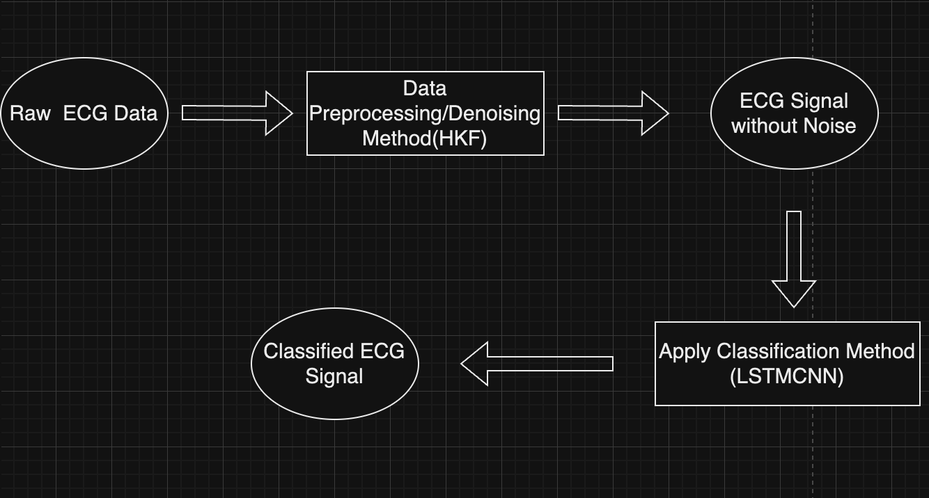
Project Workflow (Flowchart)

Slide 5
Raw ECG Data: Initial input data.
Denoising Method( HKF): Application of denoising technique to remove noise from the raw data.
ECG Signal without Noise: Denoised ECG signal obtained after applying the denoising method.
Classification Method (LSTMCNN ): Utilization of a combined classification method involving Long Short-Term Memory (LSTM) & Convolutional Neural Network (CNN).
Classified ECG Signal: ECG signal classified into different categories using the classification method.

Slide 6
Classification method
The CNNLSTM model is more efficient and effective than using CNN or LSTM alone because it combines the strengths of both architectures.
CNN captures spatial features,
LSTM captures temporal dependencies, and their combination allows for comprehensive learning of both aspects.
Capturing Spatial Features with CNN:
ECG signals contain important spatial features, such as the morphology and patterns of the waveforms.
CNN layers are highly effective in extracting local spatial features from the input signal.
The convolutional layers in the CNNLSTM model capture these spatial features at different scales, allowing the model to learn meaningful representations of the ECG signal.
By using multiple convolutional layers with increasing numbers of filters, the model can capture complex patterns and hierarchical features.

Slide 7
Capturing Temporal Dependencies with LSTM:
ECG signals also have temporal dependencies, meaning that the information from previous time steps can be relevant for classification.
LSTM is specifically designed to capture long-term dependencies and temporal patterns in sequential data.
By using an LSTM layer after the convolutional layers, the CNNLSTM model can learn and retain important temporal information from the ECG sequence.
The LSTM layer allows the model to consider the context and dependencies across different time steps, which is crucial for accurate ECG classification.
Complementary Nature of CNN and LSTM:
CNN and LSTM have complementary strengths that are leveraged in the CNNLSTM model.
CNN focuses on extracting local spatial features, while LSTM focuses on capturing temporal dependencies.
By combining these two architectures, the CNNLSTM model can effectively learn both spatial and temporal patterns in the ECG signal.
This combination allows the model to have a more comprehensive understanding of the ECG data, leading to improved classification performance.

Slide 8
Classes of Classification
N (Normal): The "N" represents a normal heartbeat or cardiac complex. It indicates that the electrical activity of the heart is within the normal range, and there are no abnormalities or irregularities in the heart rhythm.
L (Left bundle branch block): An "L" complex indicates the presence of a left bundle branch block. This is an abnormality in the electrical conduction system of the heart, where the electrical signals do not travel normally through the left bundle branch. It can affect the timing and coordination of ventricular contractions.
R (Right bundle branch block): An "R" complex indicates a right bundle branch block. Similar to left bundle branch block, this signifies an abnormality in the electrical conduction system involving the right bundle branch.
A (Atrial premature beat): An "A" complex represents an atrial premature beat, which is an early contraction originating in the atria (upper chambers of the heart) before the next expected normal heartbeat.
V (Ventricular premature beat): A "V" complex represents a ventricular premature beat, which is an early contraction originating in the ventricles (lower chambers of the heart) before the next expected normal heartbeat

Slide 9
Comparison Table
Reference Work | Classification Technique | Denoising Method | Accuracy
Our Proposed method | LSTM CNN | HKF | 98.54
 | LSTM CNN | DWT | 98.04
 | LSTM CNN | Savitzky Golay Filter | 98.23
Deep Convolutional Networks for the Classification | 1D CNN +Multi Layer Perceptron | DWT | 97.5
Acharya et al | CNN | Low pass and high pass filter | 95.11

Slide 10
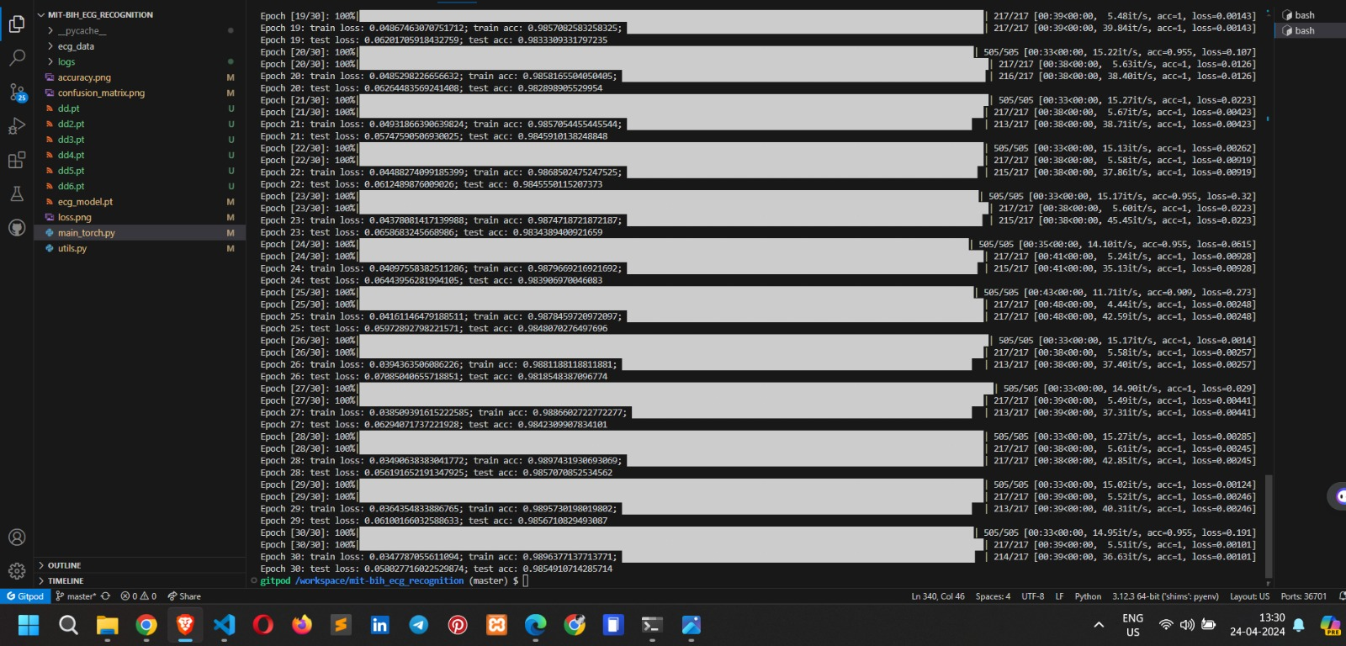
Results
Accuracy of LSTM CNN + HKF

Slide 11
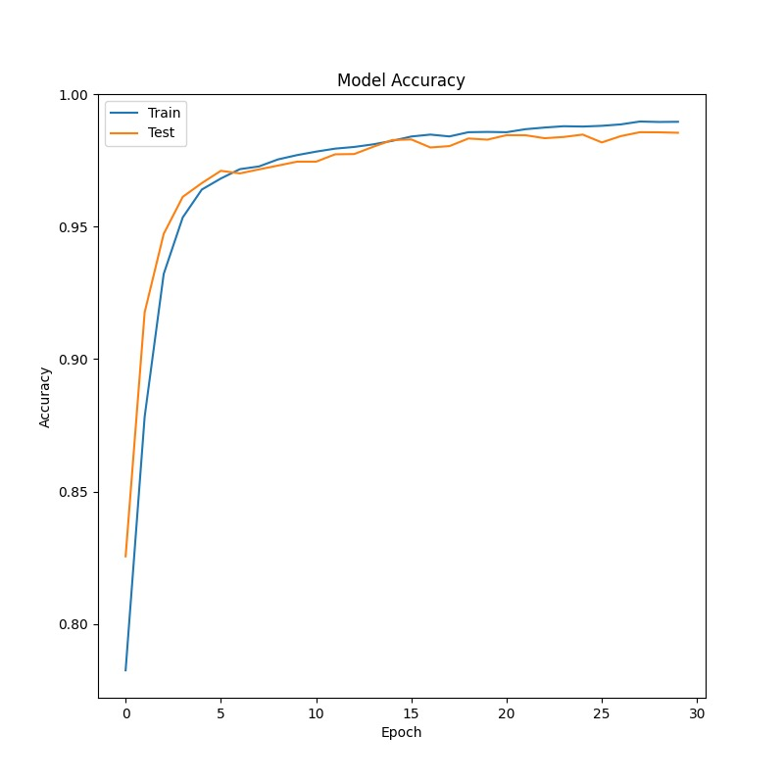
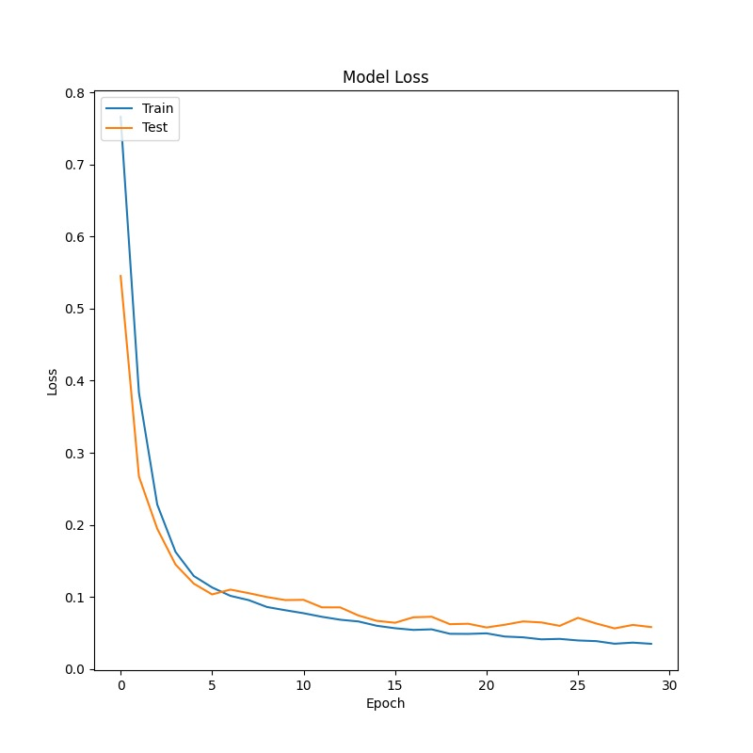
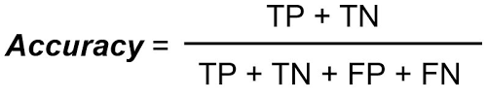

Slide 12
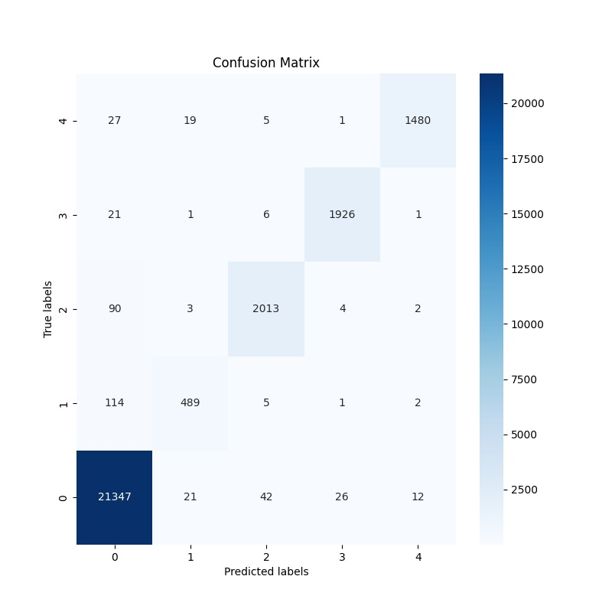
Fig. 3 gives the confusion matrix that is used to visualize the performance of the classification algorithm.

Slide 13
Conclusion
In conclusion, our study introduces a novel approach, Hierarchical Kalman Filtering , for ECG denoising. By leveraging online learning, our method effectively adapts to individual patient variations, captures intra- and inter-heartbeat dynamics, and handles diverse noise levels. This approach shows promise in enhancing the quality of ECG signals, paving the way for improved healthcare monitoring and diagnosis in real-world settings .

Slide 14
Thank You

